Slide 1
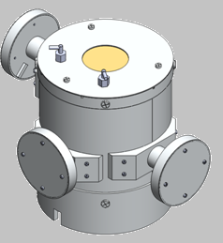
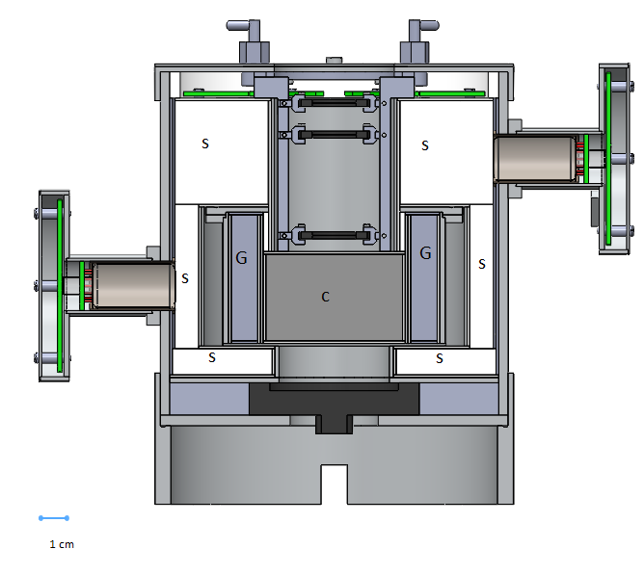
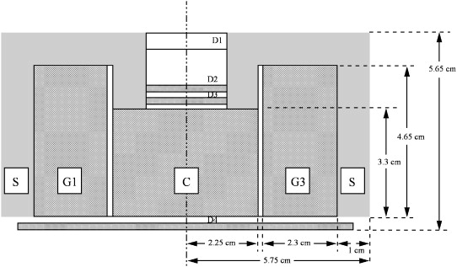
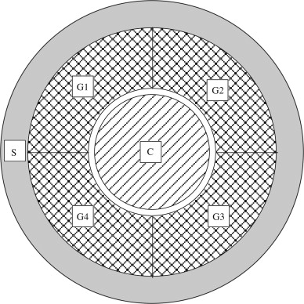
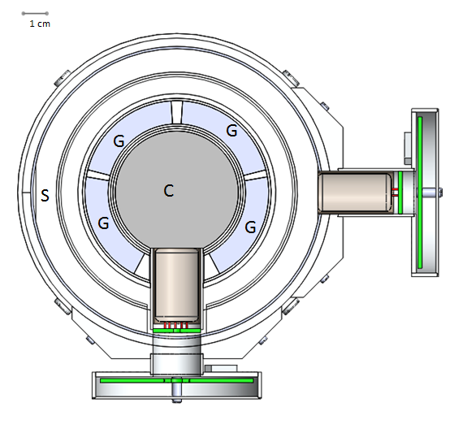
Positron Identification by Coincident Annihilation Photons (PICAP) system
B.B. Bickford
Faculty advisors - May-Win Thein, J.J. Connell
C. Lopate D. L. Tran, Space Science Center University of New Hampshire
Background and Project Goal
New design for detecting and distinguishing energetic positrons (anti electrons) from negatrons (ordinary electrons) in space
Design, build, and test a proof of principle prototype telescope
Methods
The PICAP instrument works by first using the dE/dx method versus residual energy technique to identify incoming particles. Positrons within the appropriate energy range will annihilate in the scintillation material and produce coincidental 511 keV photons. These annihilation photons are then detected by two of the four surrounding annular sections of crystal scintillators. Unwanted particle data, particles not entering through top window, will be identified by using scintillation material all around the instrument along with a large solid state detector at the bottom of the device.
Abstract
This concept is a new method for detecting moderate energy positrons and negatron in space. The current method for measuring these particles is by using a magnet spectrometer. Magnet spectrometers typically weigh greater than 10 kg, use more than 10 watts of power and require a magnet. The goal of the proposed PICAP design is to reduce these resources to provide an alternative, and more attractive space flight instrument. We estimate a flight instrument to have a weight less than 4 kg, power draw of less than 3 Watts and no magnet. As a space flight instrument this resource allotment will would make the PICAP instrument a much more desirable alternative.
Instrument Concept and Design
D1
Design Constraints
Light tight - This instrument was designed to exclude all ambient light
Reflecting light -Teflon was used around scintillators to reflect light towards the opening face of the photo multiplier tubes
Cross talk – Teflon and Aluminum was used around each of the scintillators to ensure light would not cross from one to another
7 Circuit boards and corresponding wires had to be included for the photomultiplier tubes and solid state detectors
Purging – purge ports were required to exclude contamination
Instrument was required to act as a faraday cage in order to exclude electromagnetic interference
Designed with Assembly + Disassembly capabilities
D2
PMT
PMT
D3
D4
CAD model of PICAP instrument
Side cross section view of concept design
Side cross section view of Mechanical design
Dimensions of prototype
Total Height | 16.78 cm | Total mass | 3.3 kg
Total width | 22.47 cm | Total Volume | 1985 cm^3
C- Center scintillation material (PTV)
G- Heavy scintillation material (BGO)
D- Solid state detectors
S- Plastic scintillation material (PTV)
Notes
39 different fabricated parts
designed from stock material sizes
flight instrument will have significantly fewer but much more complex parts
7 Photomultiplier tubes (PMT) and corresponding dynode circuit boards
4 Solid-State detectors
Materials; Aluminum, Teflon,
BGO, PVT, Delrin, Brass foil
Space flight instrument will be fabricated with magnesium rather than aluminum, this is expected to drop the total weight by roughly 1 kg
PMT
Testing and Analysis
Venting analysis - to ensure the change in pressure between the inside and outside of the
telescope won't have adverse effects such as structural failures or separations of joined parts.
A ventilation area of 2.31 cm^2 is required for flight instrument
Gamma ray absorption probability - calculations were performed to determine the required thickness of the scintillator based on the material
Thickness required for annular sections: BGO .94cm
CsI 2.3cm
Thermal Analysis - was done to model the telescope with the effects of temperature due to
radiation from the sun
Max temperature allowed 383 K (110 C°)
Max temperature found 331 K (58 C°)
Vibration simulations - FEA software was used to find the natural frequencies of the telescope
Greater then 50 Hz is required for flight instrument
First five natural frequencies (Hz):
PMT
Top cross section view of concept design
Top cross section view of Mechanical design
Future plans
Finish fabrications
Test at the Idaho State cyclotron, and Mass General Hospital proton beam
References
1277.7 | 1286.4 | 2070.6 | 2484.5 | 4055
Connell, J., J. Kalainoff, and C. Lopate. "Design Concept and Modeling of a New Positron Identification by Coincident Annihilation Photons (PICAP) System." Nuclear Instruments and Methods in Physics Research Section A: Accelerators, Spectrometers, Detectors and Associated Equipment 593.3 (2008): 431-39. Print.

